Slide 1
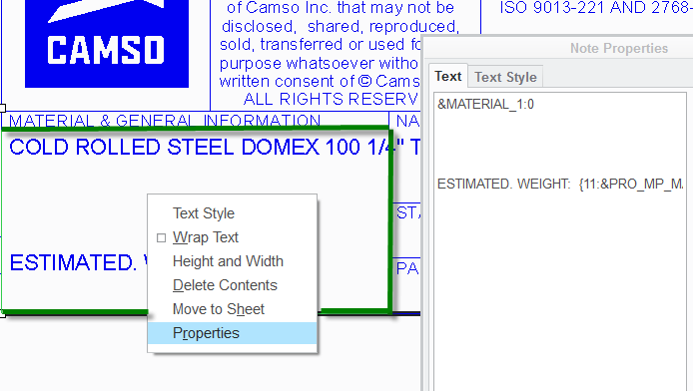
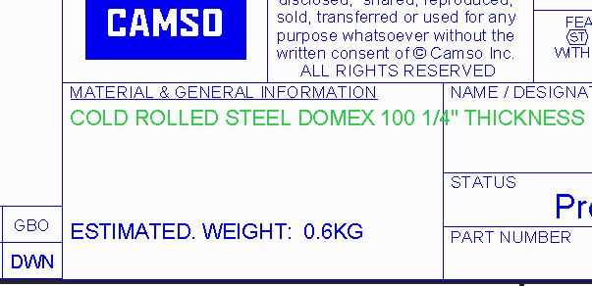

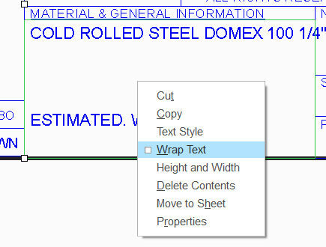


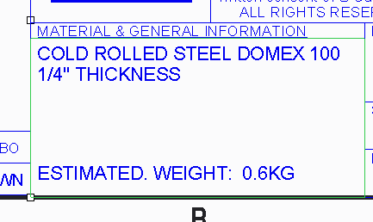
How to add a parameter and wrap text in a drawing table
Holding left alt key. Select the material cell.
Right click then properties
Add: &MATERIAL_1
c
1
a
b
d. If the text is too long (as the image) go to point 3
2
NOTE: If you changed your mind you can click “undo check-out” to keep the existing file as is.
e. Holding left alt key. Select the cell.
f. Right click and select Wrap text.
e
3
f
CAUTION: Validate that no text has shifted out of the cell. (Like if you edit the material cell the estimated weight could shift down)
Tool Tips
Instead of using the move function you can use the Cut function.
4

